Slide 1
UNIT ONE VOCABULARY
Unit 1: Number System Fluency

Slide 2
Algorithm
A step-by-step method used to solve a problem

Slide 3
Difference
The result when two numbers are subtracted

Slide 4
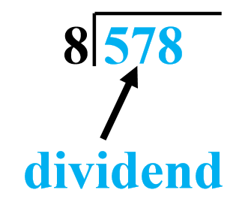
Dividend
The number being divided

Slide 5
Divisibility
A number has divisibility when it can be divided evenly without a remainder

Slide 6
Divisor
A number that divides into the dividend

Slide 7
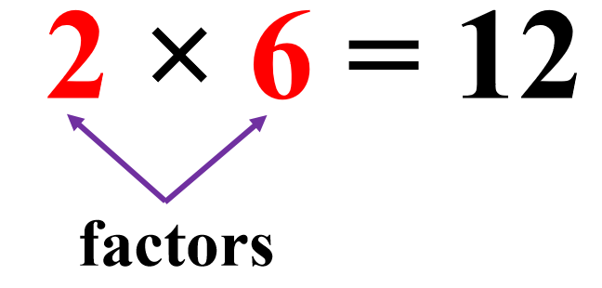
Factor
A whole number that divides exactly into another number

Slide 8
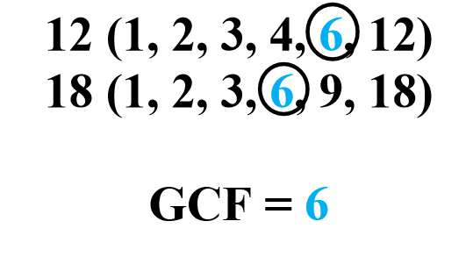
Greatest Common Factor (GCF)
The biggest number that will divide two or more numbers exactly

Slide 9
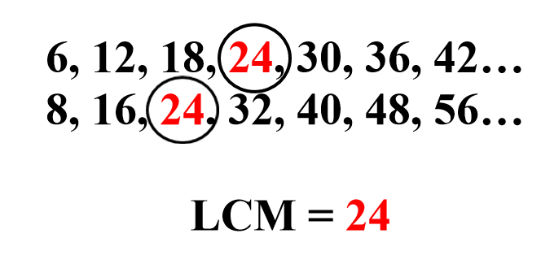
Least Common Multiple (LCM)
The smallest number that is the multiple of two or more numbers

Slide 10
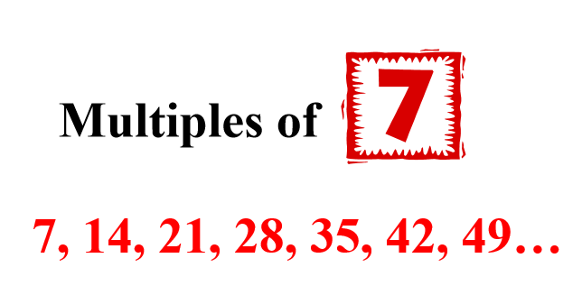
Multiple
The product of a number and any whole number

Slide 11
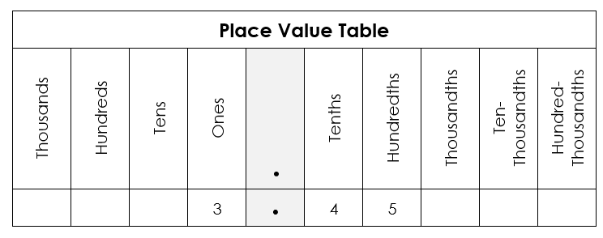
Place Value
The value of a digit depending on its place in a number

Slide 12
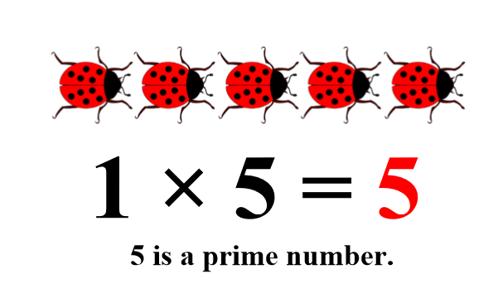
Prime Number
A number that has exactly two factors, one and itself

Slide 13
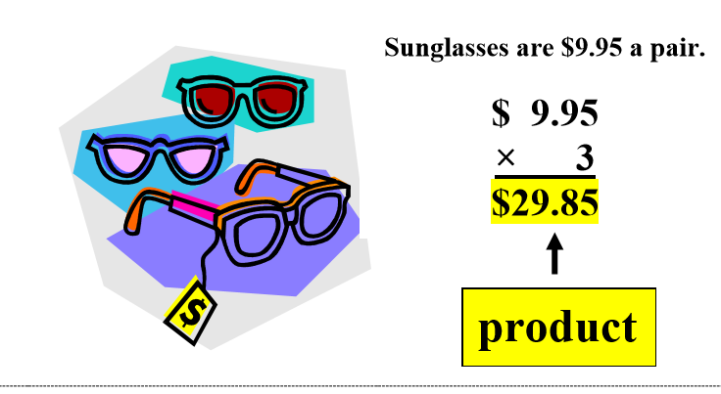
Product
The result when two quantities are multiplies

Slide 14
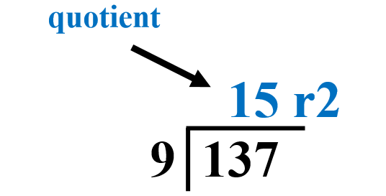
Quotient
The number that results from dividing one number from another

Slide 15
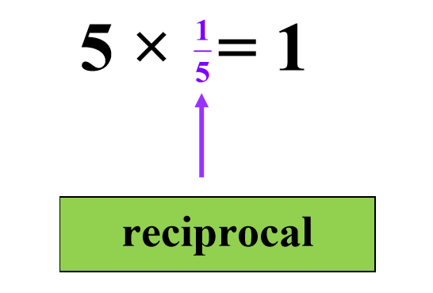
Reciprocal
One of two numbers whose product is 1; the result of “flipping” a fraction

Slide 16
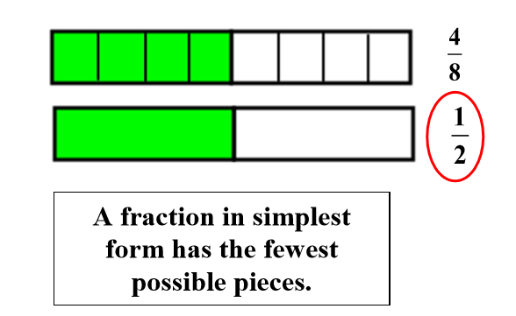
Simplify
To reduce the numerator and denominator of a fraction to the smallest numbers possible

Slide 17
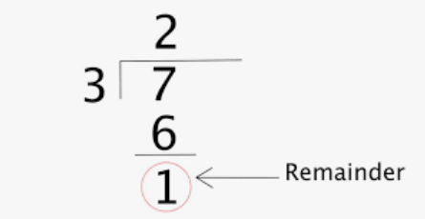
Remainder
The part “left over” in division.

Slide 18
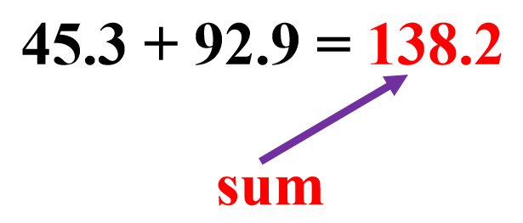
Sum
The result of adding

